Slide 1

Data Types and Operators
Variables, Data Types & Arithmetic Operators
Produced
by:
Department of Computing and Mathematics

Slide 2
Topics list
Variables.
Assignment statement.
Data Types.
Java’s Primitive Data Types
Whole numbers.
Decimal numbers.
Others.
Arithmetic operators and Order of Evaluation.

Slide 3
Variables
In Programming, variables:
are created (defined) in your programs.
are used to store data (whose value can change over time).
have a data type.
have a name.
are a VERY important programming concept.

Slide 4
Variable names…
Are case-sensitive.
Begin with either:
a letter (preferable),
the dollar sign "$", or
the underscore character "_".
Can contain letters, digits, dollar signs, or underscore characters.
Can be any length you choose.
Must not be a keyword or reserved word e.g. int, while, etc.
Cannot contain white spaces (i.e. space bar value).
https://docs.oracle.com/javase/tutorial/java/nutsandbolts/variables.html

Slide 5
Variable names should be carefully chosen
Use full words instead of cryptic abbreviations e.g.
variables named speed and gear are much more intuitive than abbreviated versions, such as s and g.
If the name consists of:
only one word, spell that word in all lowercase letters e.g. ratio.
more than one word, capitalise the first letter of each subsequent word e.g. gearRatio and currentGear.
https://docs.oracle.com/javase/tutorial/java/nutsandbolts/variables.html

Slide 6
Topics list
Variables.
Assignment statement.
Data Types.
Java’s Primitive Data Types
Whole numbers.
Decimal numbers.
Others.
Arithmetic operators and Order of Evaluation.

Slide 7
Assignment Statement
Values are stored in variables via assignment statements:
A variable stores a single value, so any previous value is lost.
Assignment statements work by taking the value of what appears on the right-hand side of the operator and copying that value into a variable on the left-hand side.
Syntax | variable = expression;
Example | numberOfItems = 100;

Slide 8
Topics list
Variables.
Assignment statement.
Data Types.
Java’s Primitive Data Types
Whole numbers.
Decimal numbers.
Others.
Arithmetic operators and Order of Evaluation.

Slide 9
Data Types
In Java, when we define a variable, we have to give it a data type.
The data type defines the kinds of values (data) that can be stored in the variable e.g.
- 456
2
45.7897
I Love Programming
S
true
The data type also determines the operations that may be performed on it.

Slide 10
Topics list
Variables.
Assignment statement.
Data Types.
Java’s Primitive Data Types
Whole numbers.
Decimal numbers.
Others.
Arithmetic operators and Order of Evaluation.

Slide 11
Java’s Primitive Data Types
Java programming language has eight primitive data types.
A primitive type is predefined by the language and is named by a reserved keyword.
A primitive type is highlighted red when it is typed into the PDE e.g.
int a;
boolean flag;
float number;

Slide 12
Topics list
Variables.
Assignment statement.
Data Types.
Java’s Primitive Data Types
Whole numbers.
Decimal numbers.
Others.
Arithmetic operators and Order of Evaluation.

Slide 13
Java’s Primitive Data Types (whole numbers)
Type | Byte-size | Minimum value (inclusive) | Maximum value (inclusive) | Default value | Typical Use
byte | 8-bit | -128 | 127 | 0 | Useful in applications where memory savings apply.
short | 16-bit | -32,768 | 32,767 | 0
int | 32-bit | -2,147,483,648 | 2,147,483,647 | 0 | Default choice.
long | 64-bit | -9,223,372,036,854,775,808 | 9,223,372,036,854,775,807 | 0L | Used when you need a data type with a range of values larger than that provided by int.

Slide 14
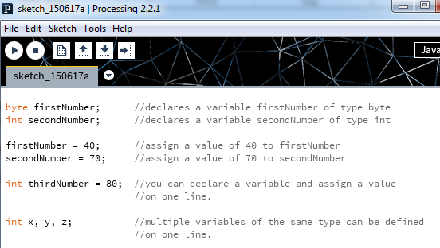
Declaring variables of a specific type
Notes:
byte firstNumber; //declares a variable firstNumber of type byte
int secondNumber; //declares a variable secondNumber of type int
firstNumber = 40; //assign a value of 40 to firstNumber
secondNumber = 70; //assign a value of 70 to secondNumber
int thirdNumber = 80; //you can declare a variable and assign a value
//on one line.
int x, y, z; //multiple variables of the same type can be defined
//on one line.

Slide 15
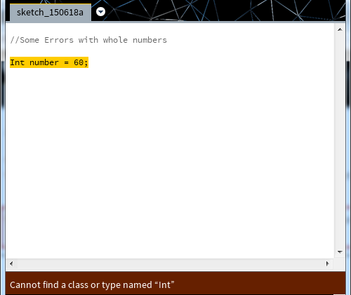
Declaring variables - some errors
Data types are case sensitive.
Int is not valid.
int is valid.
Notes:
int number = 60;
int number = 56;
int anotherNumber = 58.98;

Slide 16
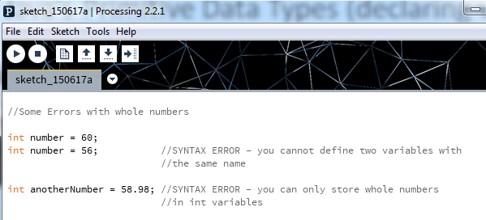
Declaring variables - some errors

Slide 17
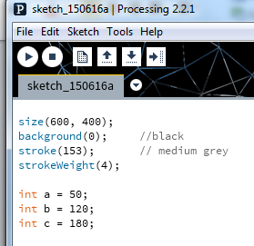
Java’s Primitive Data Types: int Example 3.1
In this example, we have:
defined three variables (a, b and c)
that can hold whole numbers (int).
and are set with a starting value.
Based on the Processing Example: Basics → Data → Variables

Slide 18
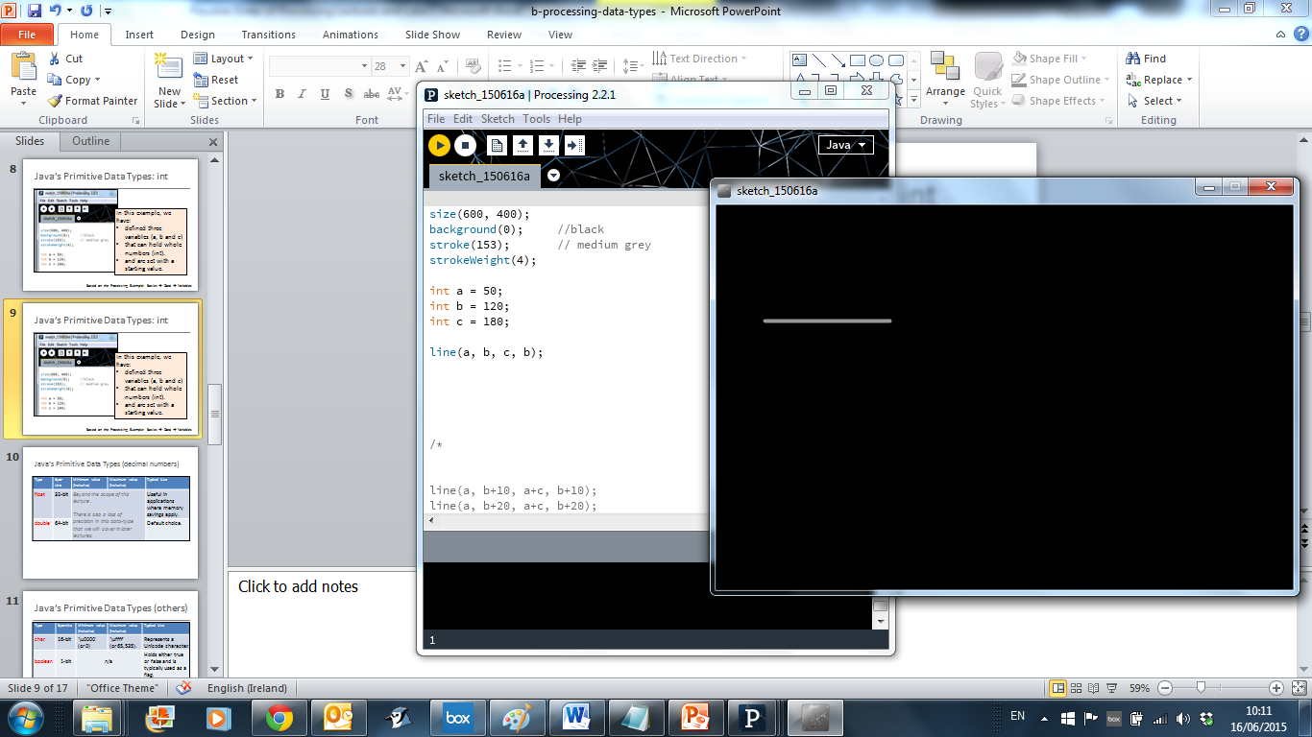
Java’s Primitive Data Types: int Example 3.2
We can pass the defined variables as values to functions.
Based on the Processing Example: Basics → Data → Variables

Slide 19
Java’s Primitive Data Types: int Example 3.3
Could we have used the byte data type instead of int? Why?
Type | Minimum value (inclusive) | Maximum value (inclusive)
byte | -128 | 127
short | -32,768 | 32,767
int | -2,147,483,648 | 2,147,483,647
long | -9,223,372,036,854,775,808 | 9,223,372,036,854,775,807
Based on the Processing Example: Basics → Data → Variables

Slide 20
Topics list
Variables.
Assignment statement.
Data Types.
Java’s Primitive Data Types
Whole numbers.
Decimal numbers.
Others.
Arithmetic operators and Order of Evaluation.

Slide 21
Java’s Primitive Data Types (decimal numbers)
Type | Byte-size | Minimum value (inclusive) | Maximum value (inclusive) | Default value | Typical Use
float | 32-bit | Beyond the scope of this course. |  | 0.0f | Useful in applications where memory savings apply. Default choice when using Processing.
double | 64-bit | Beyond the scope of this course. |  | 0.0d | Default choice when programming Java apps.

Slide 22
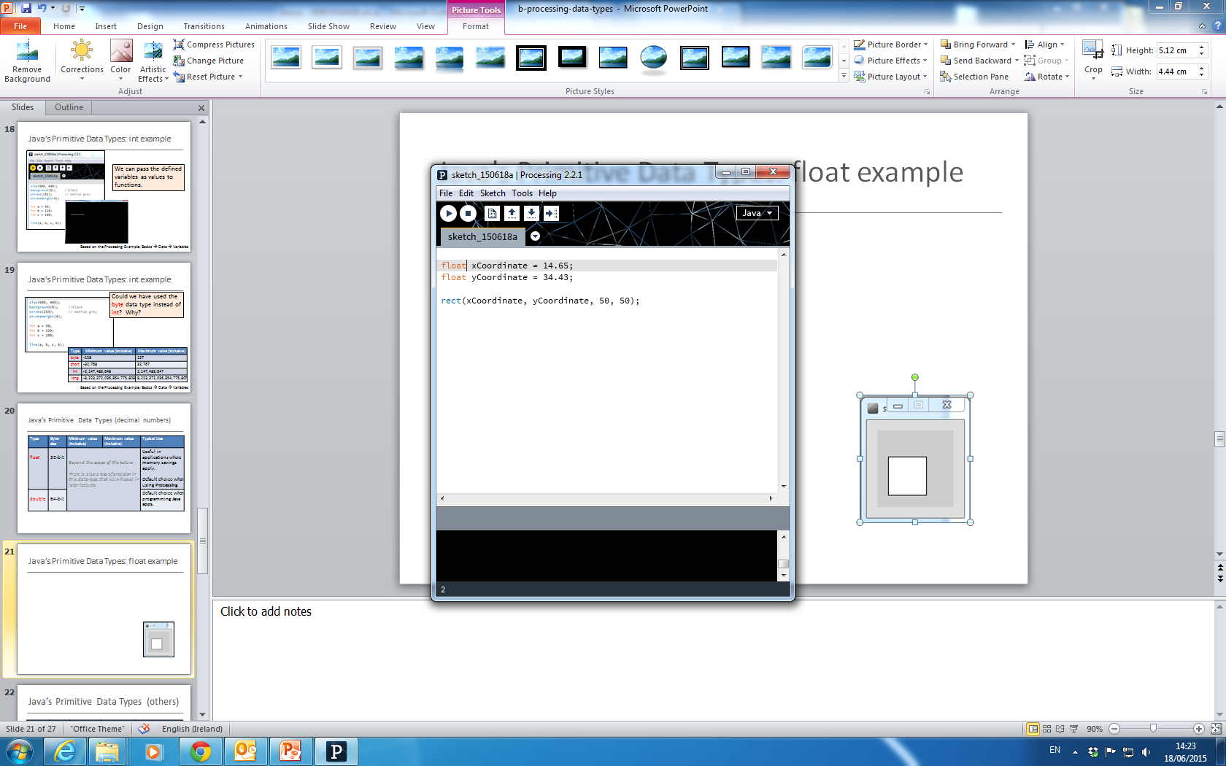
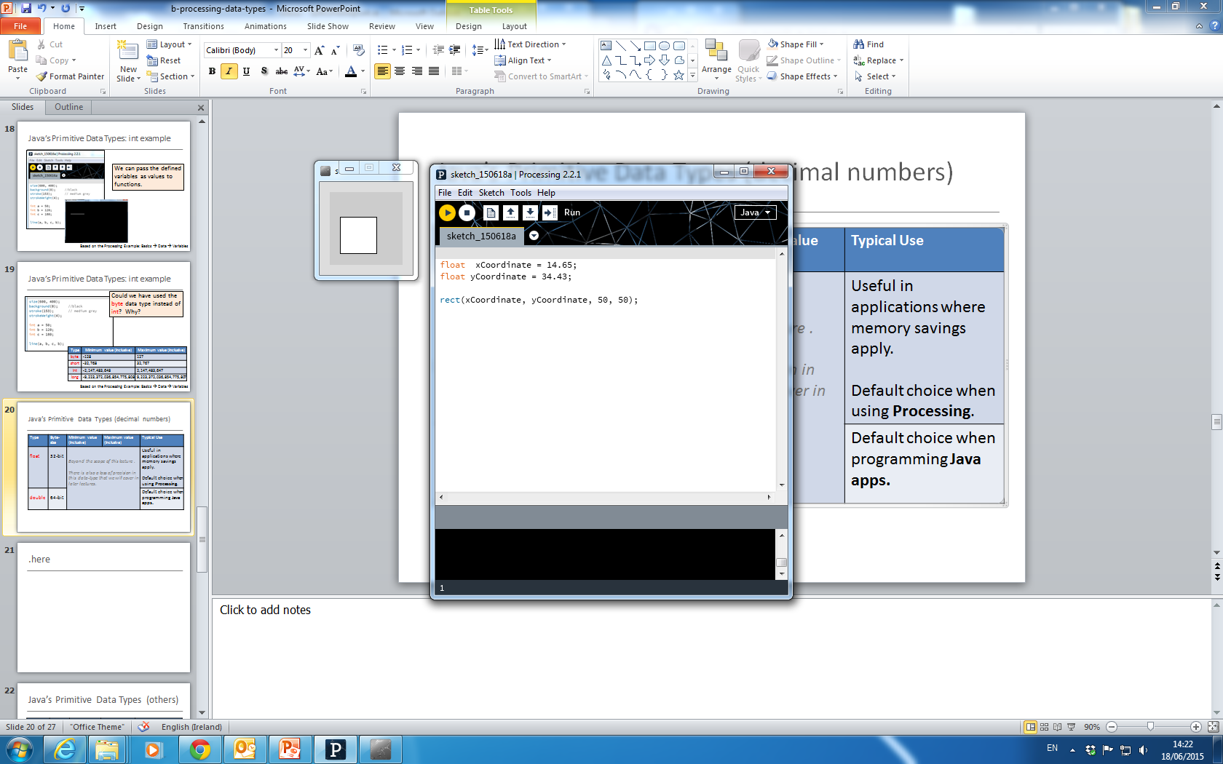
Java’s Primitive Data Types: float Example 3.4
We can pass the defined variables as values to functions.

Slide 23
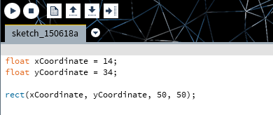
Java’s Primitive Data Types: float Example 3.5
Whole numbers can be placed into a float variable.
Q: Why?
A: There is no loss of precision. We are not loosing any data.

Slide 24
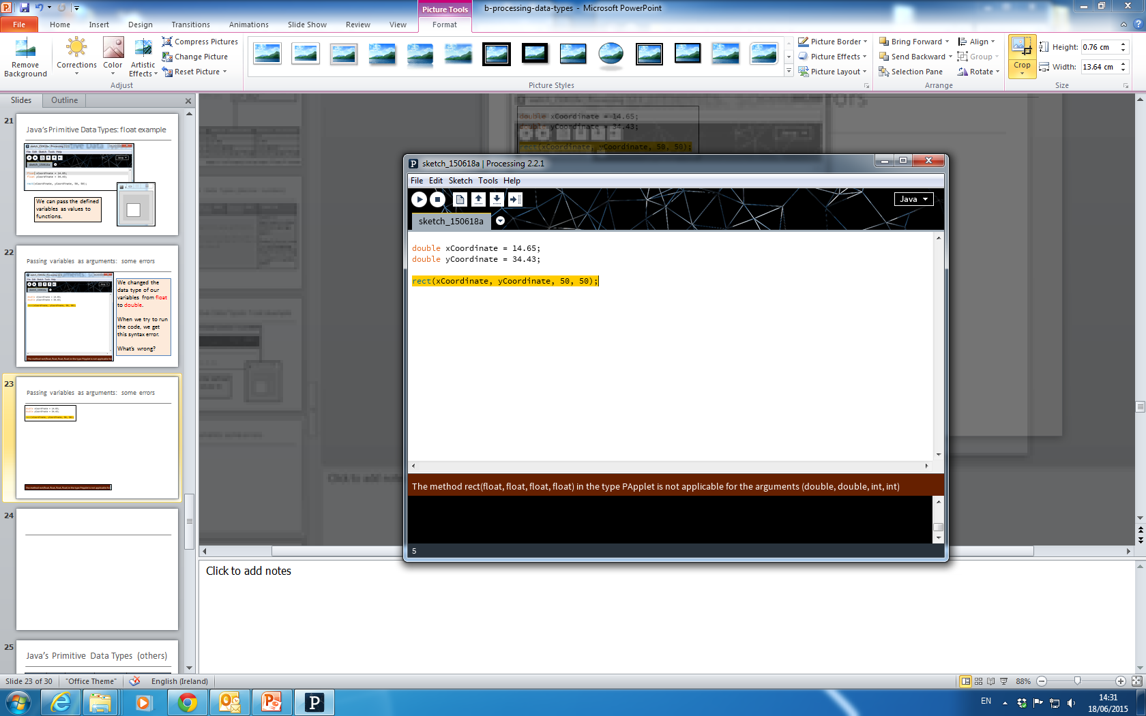
Passing variables as arguments: some errors
We changed the data type of our variables from float to double.
When we try to run the code, we get this syntax error.
What’s wrong?

Slide 25
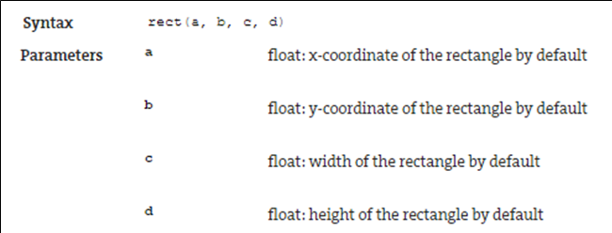
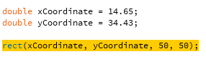
Passing variables as arguments: some errors
From: https://processing.org/reference/rect_.html

Slide 26
Topics list
Variables.
Assignment statement.
Data Types.
Java’s Primitive Data Types
Whole numbers.
Decimal numbers.
Others.
Arithmetic operators and Order of Evaluation.

Slide 27
Java’s Primitive Data Types (others)
Type | Byte-size | Minimum value (inclusive) | Maximum value (inclusive) | Default value | Typical Use
char | 16-bit | '\u0000' (or 0) | '\uffff' (or 65,535) | '\u0000' | Represents a Unicode character.
boolean | 1-bit | n/a |  | false | Holds either true or false and is typically used as a flag.
http://en.wikipedia.org/wiki/List_of_Unicode_characters

Slide 28
Topics list
Variables.
Assignment statement.
Data Types.
Java’s Primitive Data Types
Whole numbers.
Decimal numbers.
Others.
Arithmetic operators and Order of Evaluation.

Slide 29
Arithmetic Operators
Arithmetic Operator | Explanation | Example(s)
+ | Addition | 6 + 2 amountOwed + 10
- | Subtraction | 6 – 2 amountOwed – 10
* | Multiplication | 6 * 2 amountOwed * 10
/ | Division | 6 / 2 amountOwed / 10

Slide 30
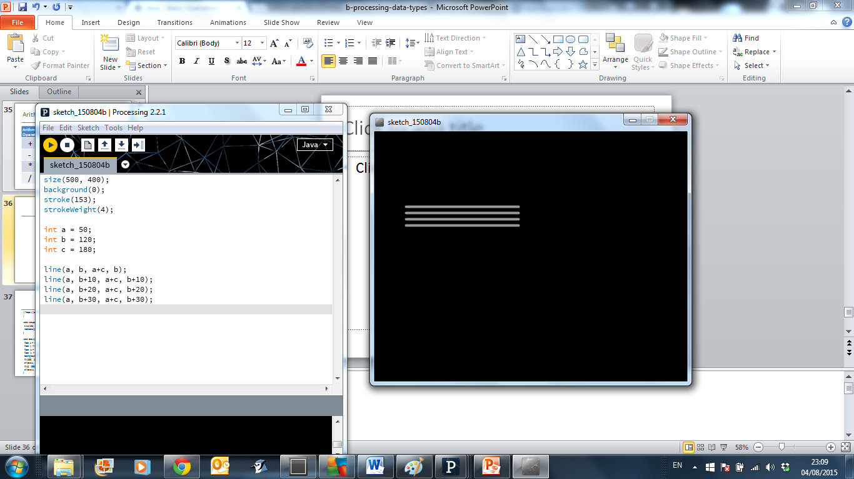
Arithmetic operators: Example 3.6
Based on the Processing Example: Basics → Data → Variables
Notes:
size(500, 400);
background(0);
stroke(153);
strokeWeight(4);
int a = 50;
int b = 120;
int c = 180;
line(a, b, a+c, b);
line(a, b+10, a+c, b+10);
line(a, b+20, a+c, b+20);
line(a, b+30, a+c, b+30);

Slide 31
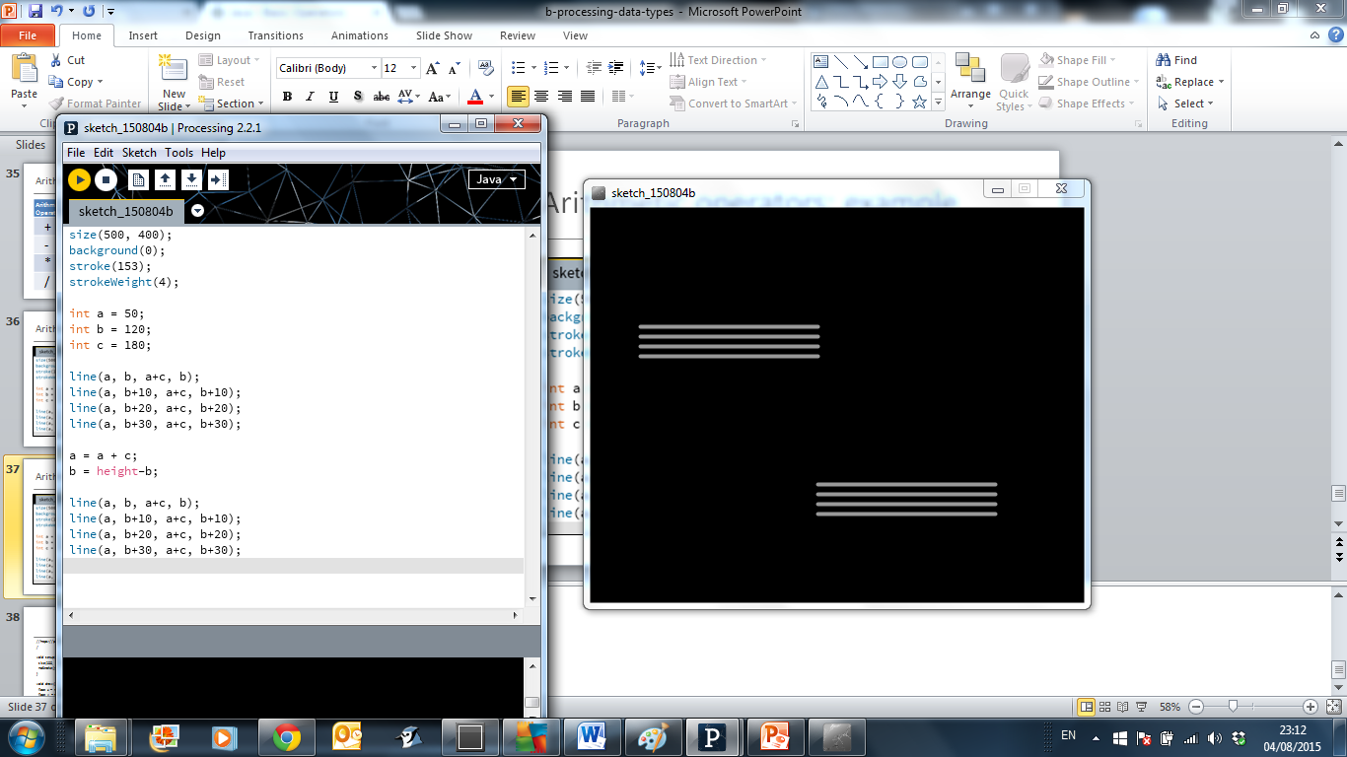
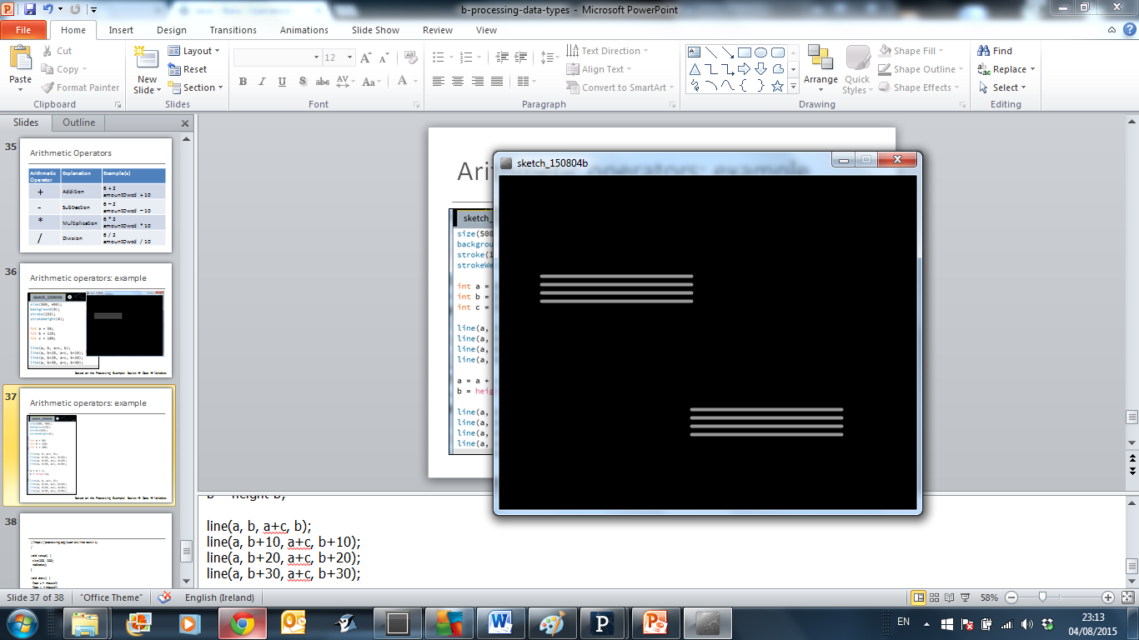
Arithmetic operators: Example 3.7
Based on the Processing Example: Basics → Data → Variables
Notes:
size(500, 400);
background(0);
stroke(153);
strokeWeight(4);
int a = 50;
int b = 120;
int c = 180;
line(a, b, a+c, b);
line(a, b+10, a+c, b+10);
line(a, b+20, a+c, b+20);
line(a, b+30, a+c, b+30);
a = a + c;
b = height-b;
line(a, b, a+c, b);
line(a, b+10, a+c, b+10);
line(a, b+20, a+c, b+20);
line(a, b+30, a+c, b+30);

Slide 32
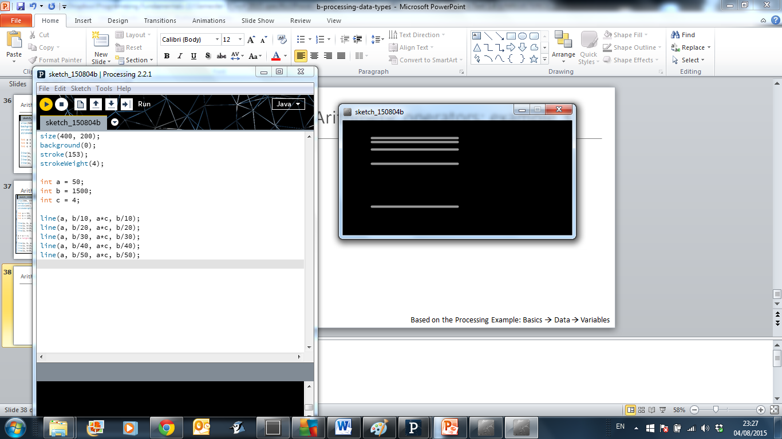
Arithmetic operators: Example 3.8
Based on the Processing Example: Basics → Data → Variables
Notes:
size(400, 200);
background(0);
stroke(153);
strokeWeight(4);
int a = 50;
int b = 1500;
int c = 4;
line(a, b/10, a*c, b/10);
line(a, b/20, a*c, b/20);
line(a, b/30, a*c, b/30);
line(a, b/40, a*c, b/40);
line(a, b/50, a*c, b/50);

Slide 33
Arithmetic Operators
If you want to keep track of how many times something happens, you are keeping a running total e.g.
The number of times you drew a line on the computer screen.
As each line is drawn, you add one to your counter variable.

Slide 34
Arithmetic Operators
int counter = 0;
void draw()
{
line (mouseX, mouseY, 50,50);
counter = counter + 1;
println (counter);
}

Slide 35
Arithmetic Operators
These examples are straightforward uses of the arithmetic operators.
However, we typically want to do more complex calculations involving many arithmetic operators.
To do this, we need to understand the Order of Evaluation.

Slide 36
Order of Evaluation
Brackets ()
Multiplication (*)
Division (/)
Addition (+)
Subtraction (-)
BoMDAS
Beware My Dear Aunt Sally

Slide 37
Order of Evaluation - Quiz
What are the results of these calculations?
Q1: 3+6*5-2
Q2: 3+6*(5-2)
Q3: (3+6)*5-2
Notes:
A1: 31
A2: 21
A3: 43

Slide 38

Questions?

Slide 39
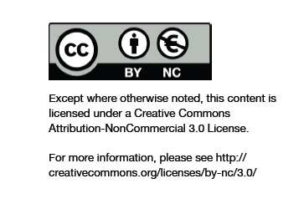
Department of Computing and Mathematics
http://www.wit.ie/

